Slide 1
College Basketball Analysis

Slide 2
About Dataset
Content
Data from the 2013, 2014, 2015, 2016, 2017, 2018, 2019, 2020, 2021, 2022, 2023 Division I college basketball seasons.
cbb.csv has seasons 2013-2019 and seasons 2021-2023 combined
The 2020 season's data set is kept separate from the other seasons, because there was no postseason due to the Coronavirus.

Slide 3
Variables
RK (Only in cbb20): The ranking of the team at the end of the regular season according to barttorvik
TEAM: The Division I college basketball school
CONF: The Athletic Conference in which the school participates in
G: Number of games played
W: Number of games won
ADJOE: Adjusted Offensive Efficiency
ADJDE: Adjusted Defensive Efficiency
BARTHAG: Power Rating (Chance of beating an average Division I team)
EFG_O: Effective Field Goal Percentage Shot
EFG_D: Effective Field Goal Percentage Allowed
TOR: Turnover Percentage Allowed (Turnover Rate)
TORD: Turnover Percentage Committed (Steal Rate)
ORB: Offensive Rebound Rate
DRB: Offensive Rebound Rate Allowed
FTR : Free Throw Rate (How often the given team shoots Free Throws)
FTRD: Free Throw Rate Allowed
2P_O: Two-Point Shooting Percentage
2P_D: Two-Point Shooting Percentage Allowed
3P_O: Three-Point Shooting Percentage
3P_D: Three-Point Shooting Percentage Allowed
ADJ_T: Adjusted Tempo
WAB: Wins Above Bubble
POSTSEASON: Round where the given team was eliminated or where their season ended
SEED: Seed in the NCAA March Madness Tournament
YEAR: Season

Slide 4


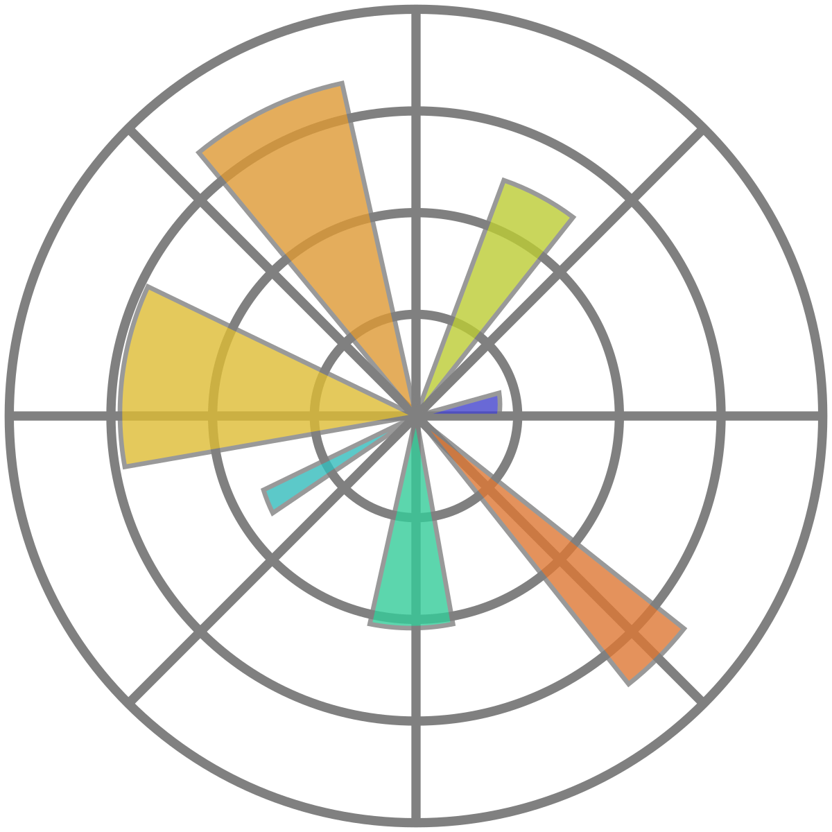

Import Libraries
Pandas
Seaborn
Matplotlib
Sklearn

Slide 5
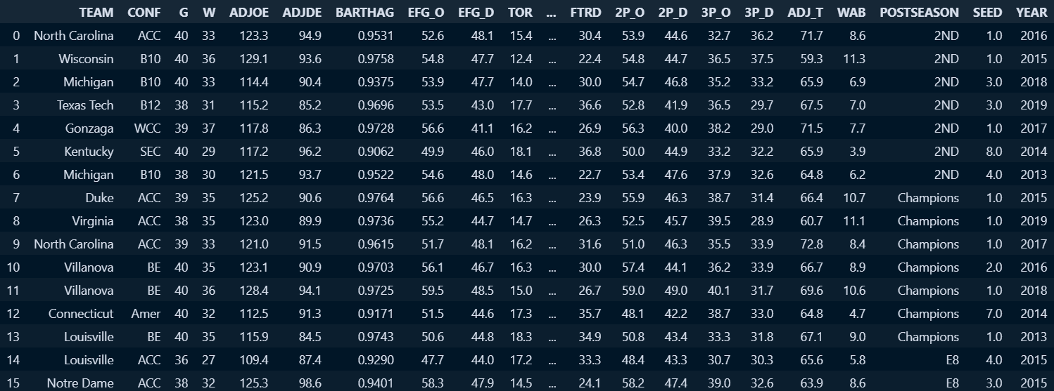
Loading data

Slide 6
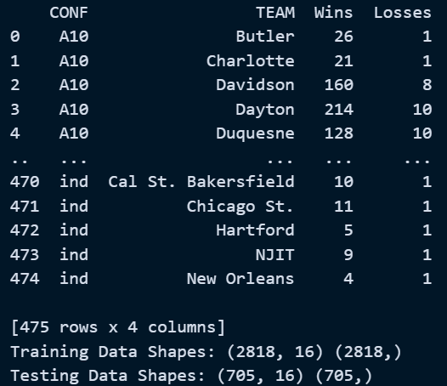
Match Prediction

Slide 7
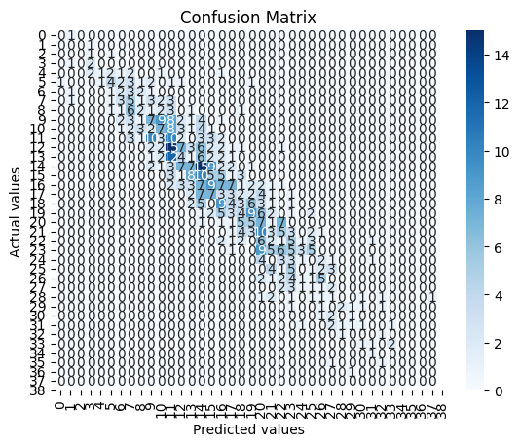
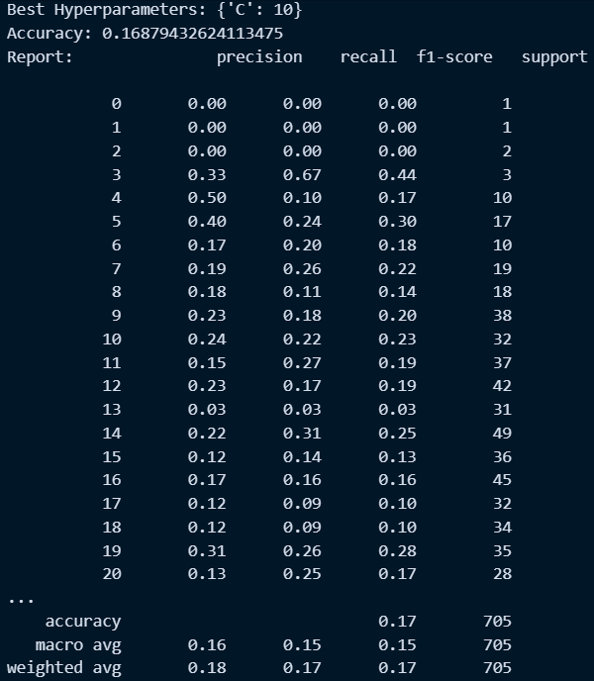
Using LogisticRegression and GridSearchCV

Slide 8
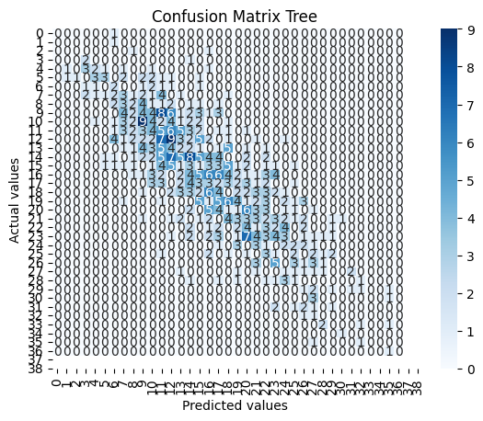
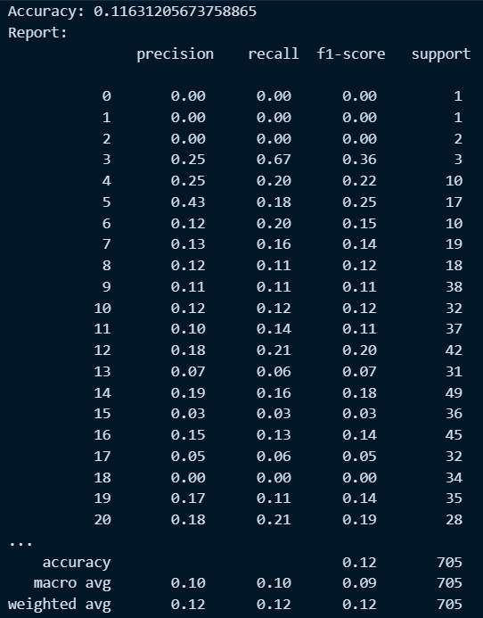
Using DecisionTree

Slide 9
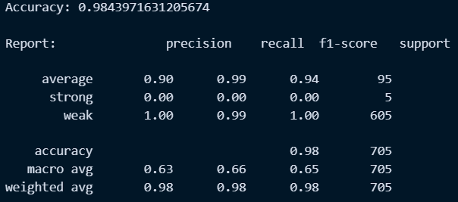
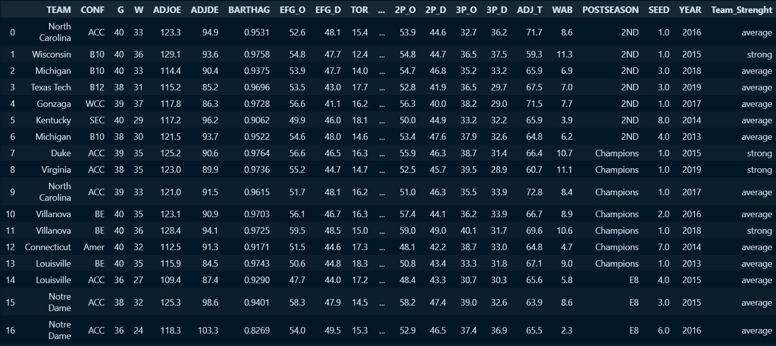
Team Classification

Slide 10
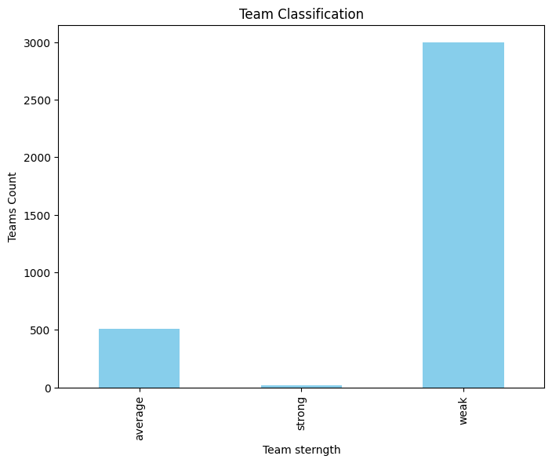
Strong teams: 16
Average teams: 507
Weak teams: 3000

Slide 11
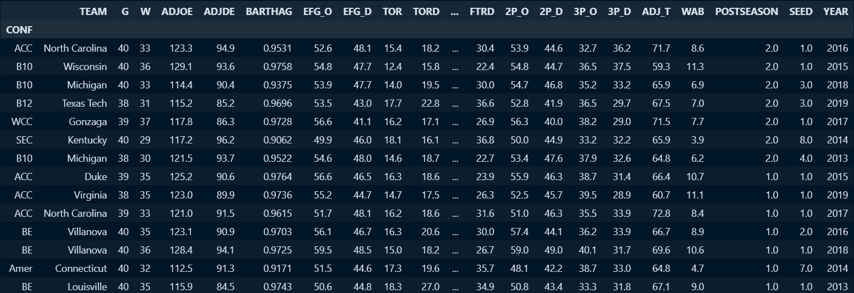
Preprocessing for a specific column in the dataset

Slide 12
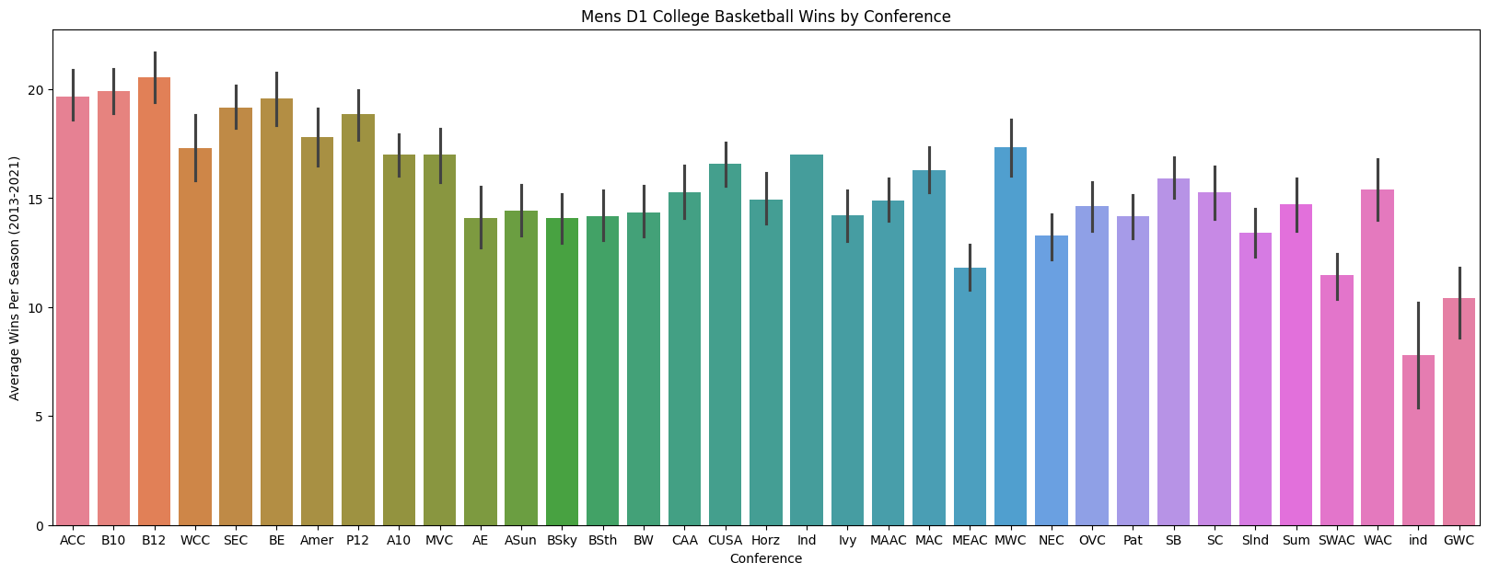
Visualization of Wins by Conference

Slide 13
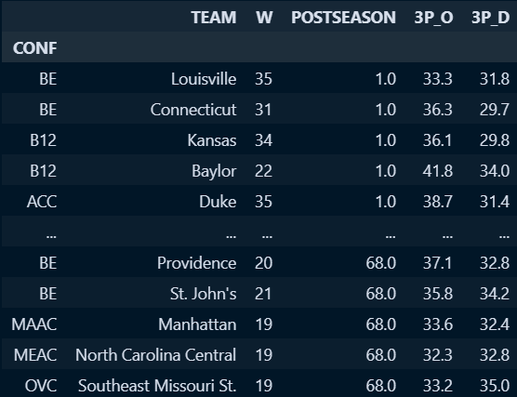
Data filtering and correlation matrix

Slide 14
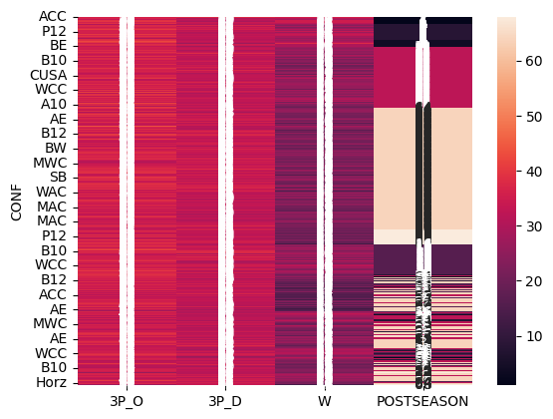
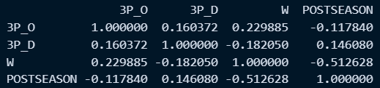
Displaying correlation matrix

Slide 15
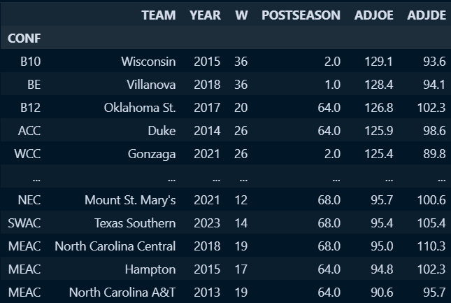
Further analysis with additional columns

Slide 16
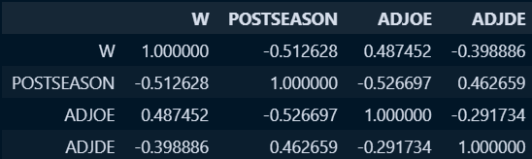
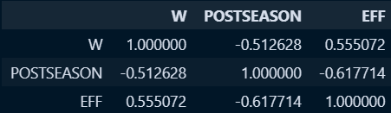
Correlation matrix for additional columns
Calculating team effectiveness

Slide 17
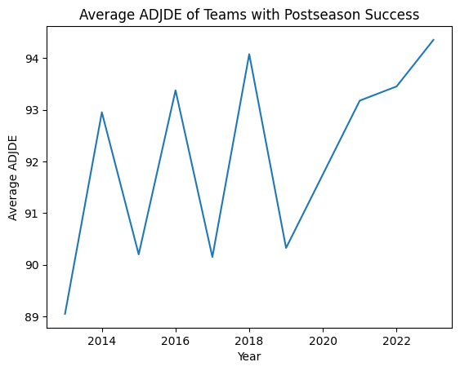
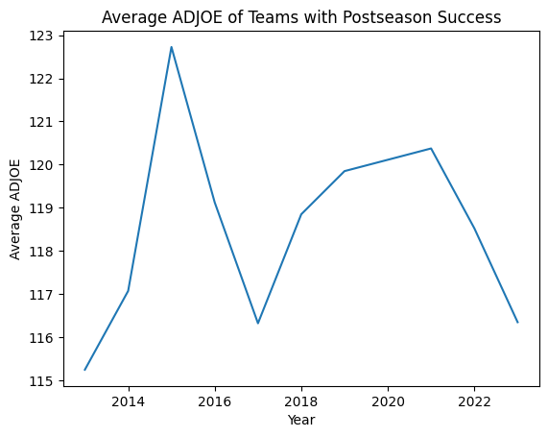
Plotting average ADJDE and ADJOE for successful postseason teams
Correlation between Postseason Success and ADJDE: 0.2653239079376732
Correlation between Postseason Success and ADJOE: -0.3726072849733545

Slide 18
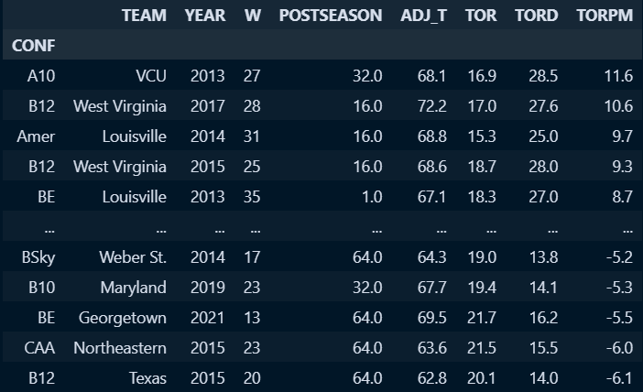
Analyzing tempo columns

Slide 19
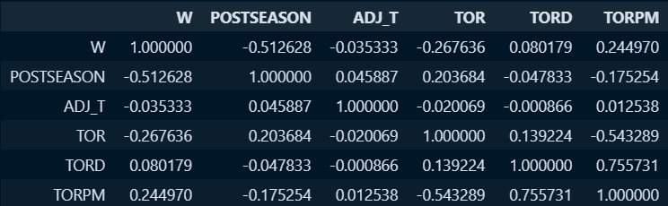
Correlation matrix for tempo-related columns

Slide 20
Predictive modeling for postseason success
[60.6 12.27 59.76 45.08 60.92 43.44 35.96 20.14 15.4 63.04] CONF
Horz 64.0
B12 8.0
AE 64.0
MVC 4.0
Pat 64.0
B12 16.0
B10 32.0
SEC 16.0
BE 32.0
SB 68.0
Name: POSTSEASON, dtype: float64
1st model MAE: 12.944941176470588

Slide 21
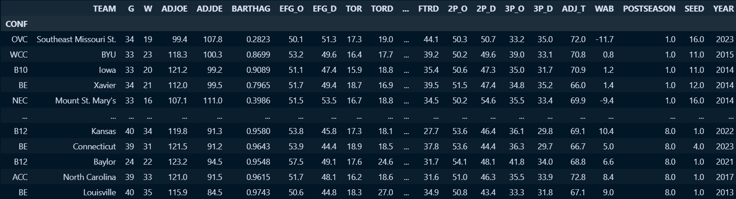
Linear mapping for postseason levels

Slide 22
Second predictive modeling with updated target
[2.17 4.96 2.09 2.79 2.06 2.91 3.65 3.89 4.4 1.97] CONF
Horz 2.0
B12 5.0
AE 2.0
MVC 6.0
Pat 2.0
B12 4.0
B10 3.0
SEC 4.0
BE 3.0
SB 1.0
Name: POSTSEASON, dtype: float64
2nd model MAE: 0.6627058823529411

Slide 23
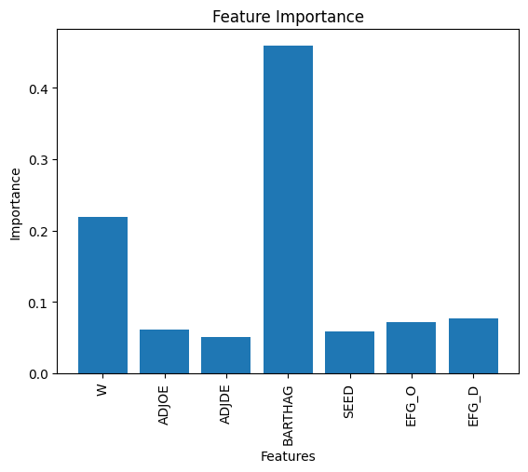
Feature importance analysis for the second model

Slide 24
Third predictive modeling with additional features
3rd model MAE: 0.6635294117647059

Slide 25
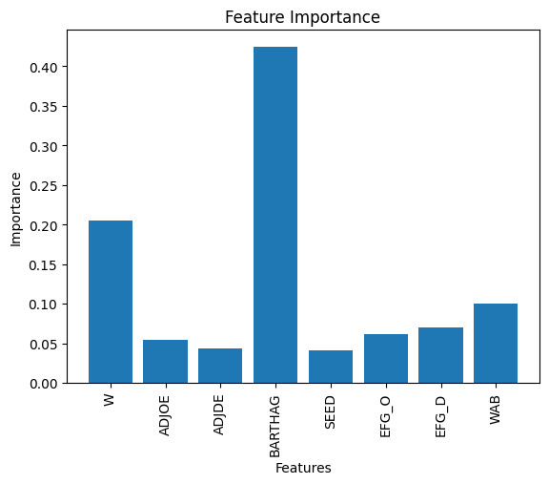
Feature importance analysis for the third model

Slide 26
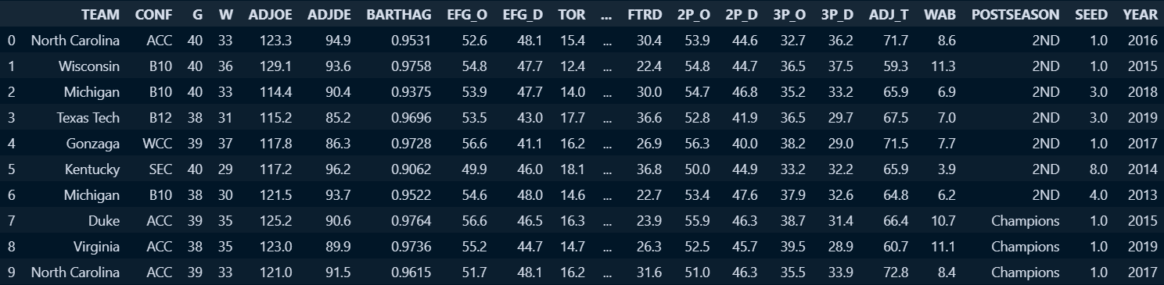
Exploratory data analysis on the original dataset

Slide 27
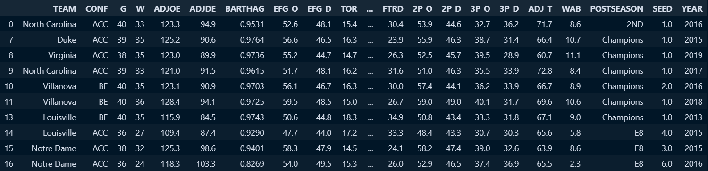
Filtering teams from specific conferences

Slide 28
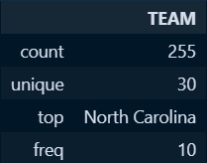
Descriptive statistics for a specific columns

Slide 29
Handling missing values and exploring specific columns
POSTSEASON
Missed Tournament 135
R64 42
R32 29
S16 19
E8 12
Champions 7
F4 5
R68 4
2ND 2
Name: count, dtype: int64
SEED
Missed Tournament 135
1.0 14
2.0 14
4.0 13
9.0 12
11.0 12
8.0 12
6.0 10
10.0 9
5.0 9
3.0 8
7.0 4
12.0 3
Name: count, dtype: int64

Slide 30
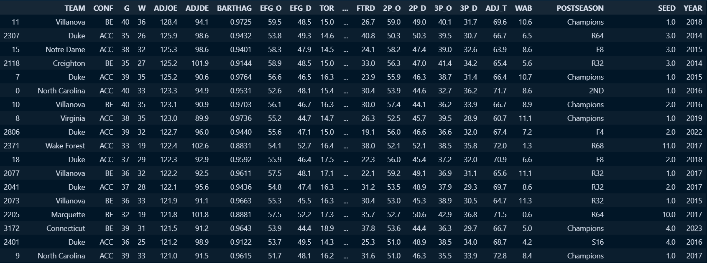
Exploring subsets of data based on specific conditions (ADJOE)

Slide 31
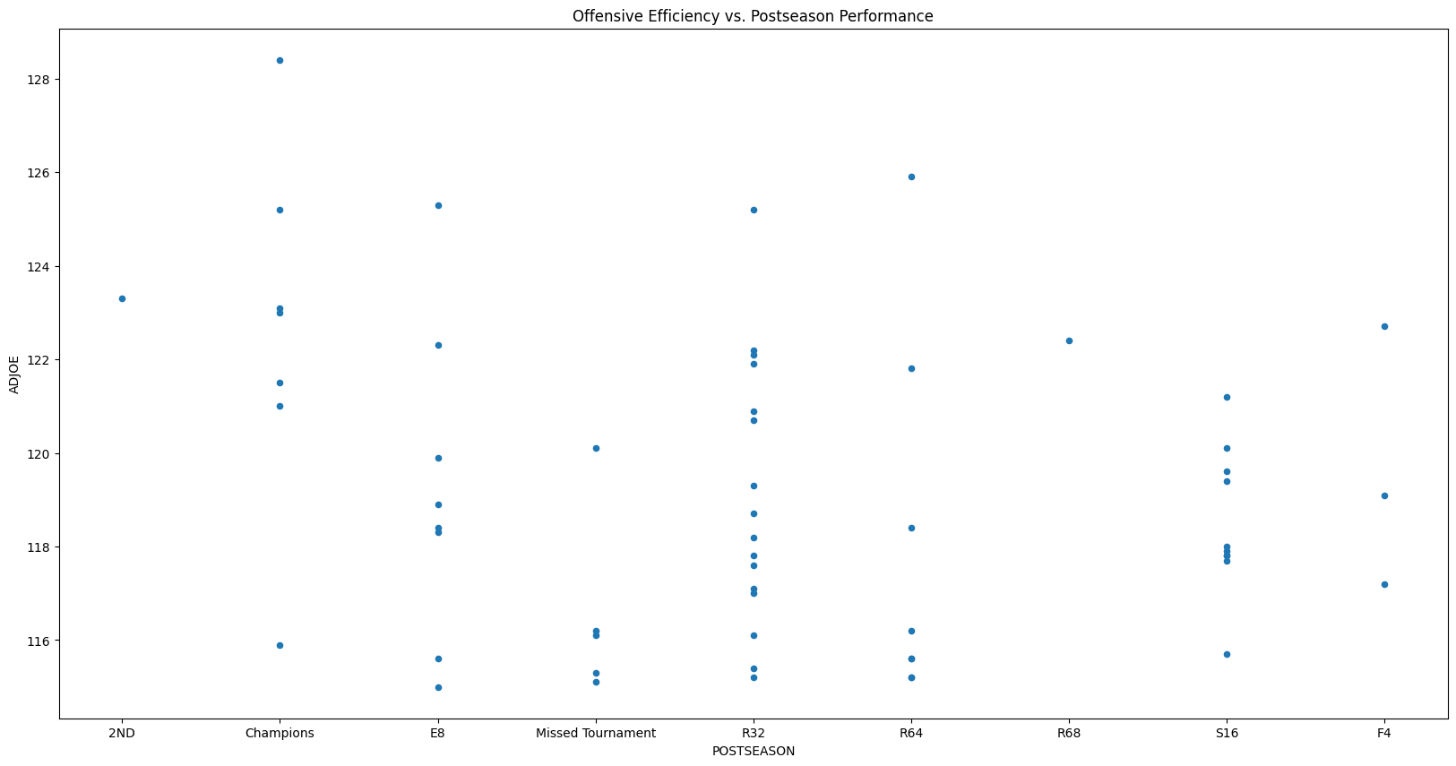
Visualization of a relationship between variables (ADJOE)

Slide 32
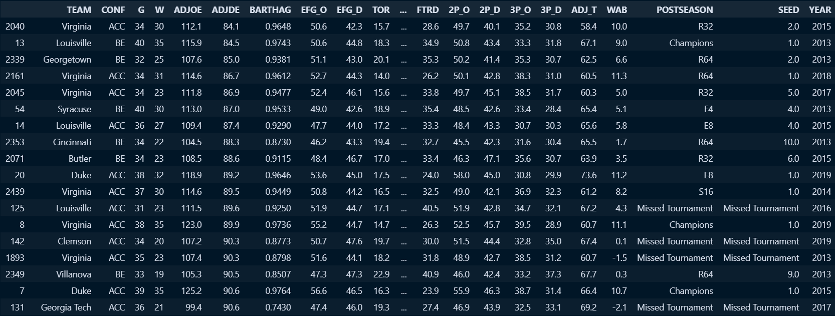
Exploring subsets of data based on specific conditions (ADJDE)

Slide 33
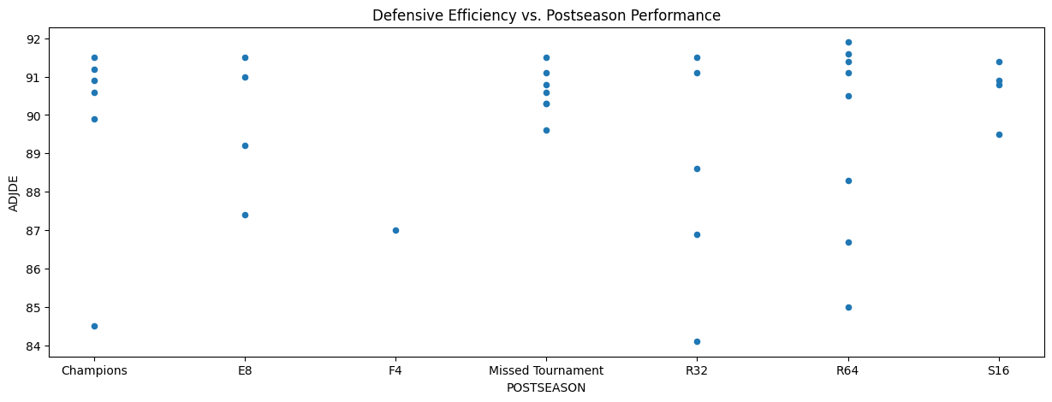
Visualization of a relationship between variables (ADJDE)

Slide 34
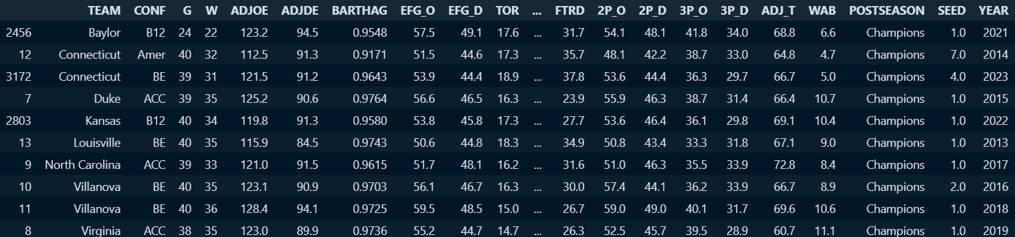
Exploring subsets of data based on specific conditions (ADJDE Champions)

Slide 35
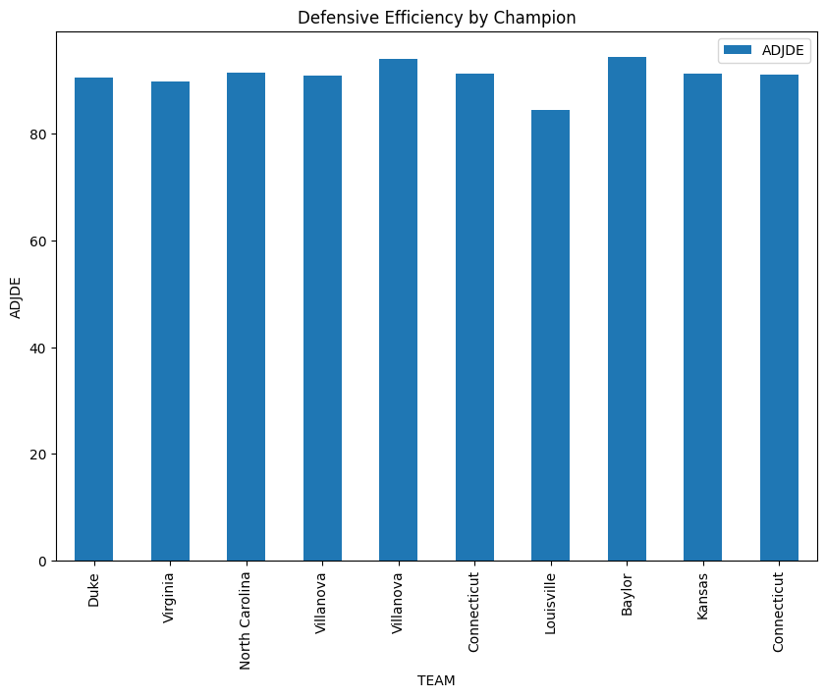
Visualization of a relationship between variables (ADJDE Champions)

Slide 36
Exploring subsets of data based on specific conditions (ADJOE Champions)

Slide 37
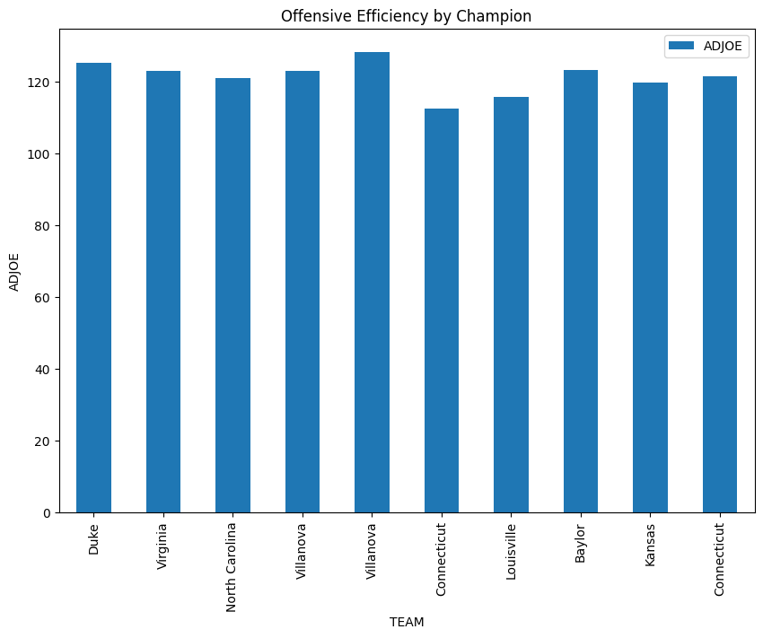
Visualization of a relationship between variables (ADJOE Champions)

Slide 38
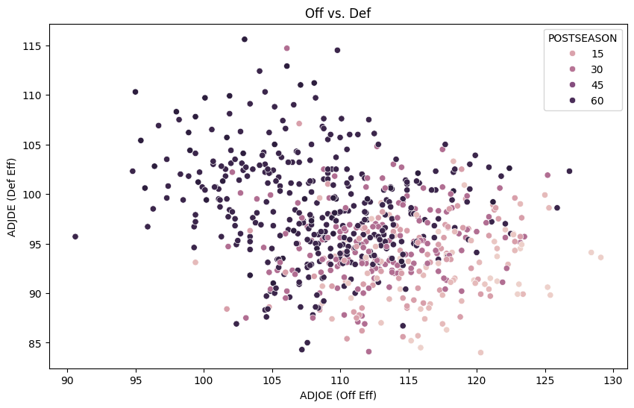
Linear Mapping

Slide 39
First model for evaluation
Regression Model Mean Absolute Error: 13.185058823529411
Classification Model Accuracy: 0.90
Rating System Model Mean Squared Error: 0.0020537310204636386

Slide 40
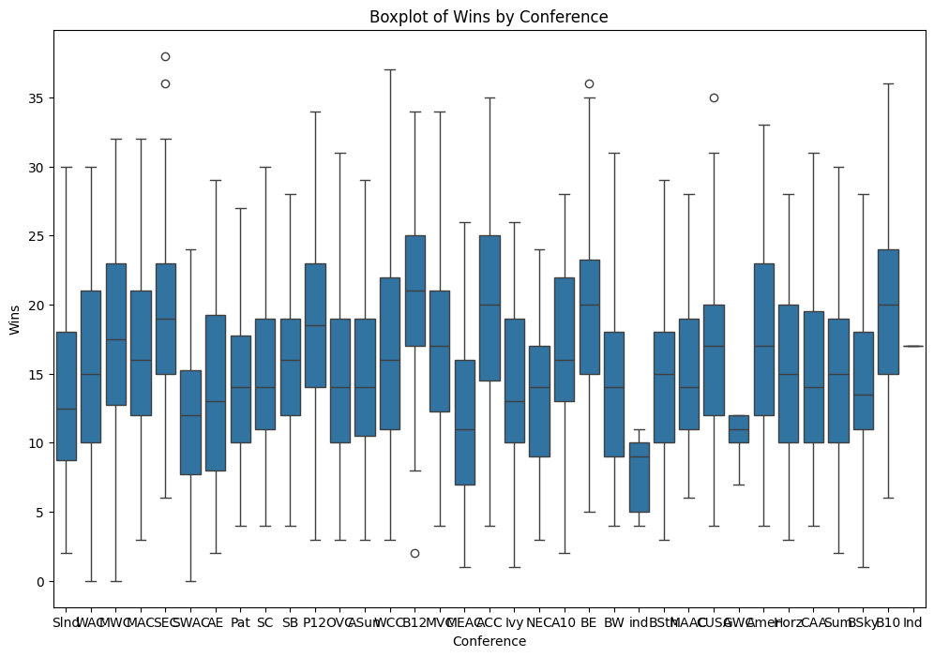

Slide 41
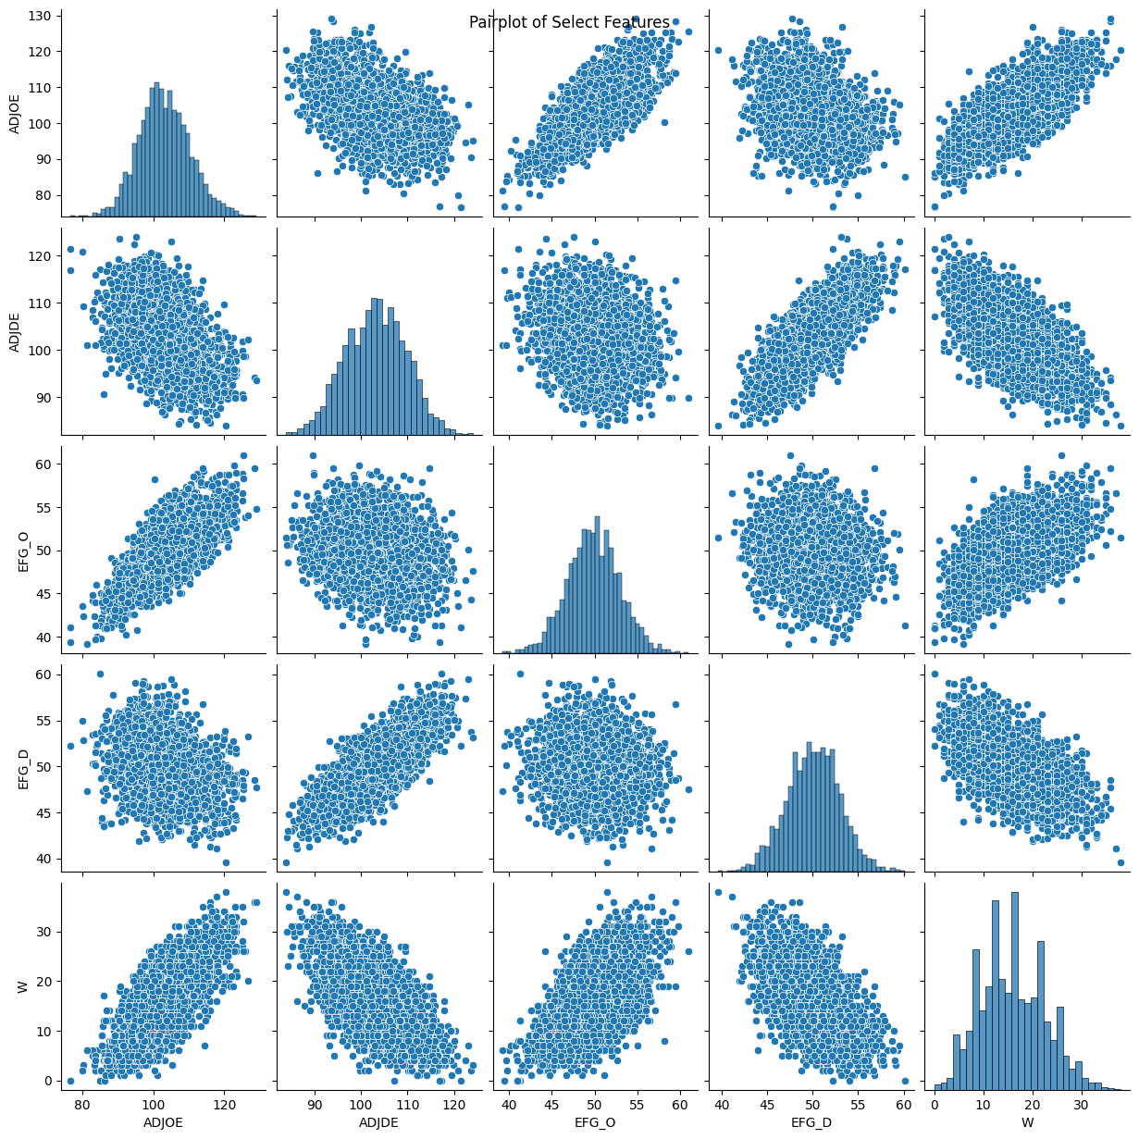
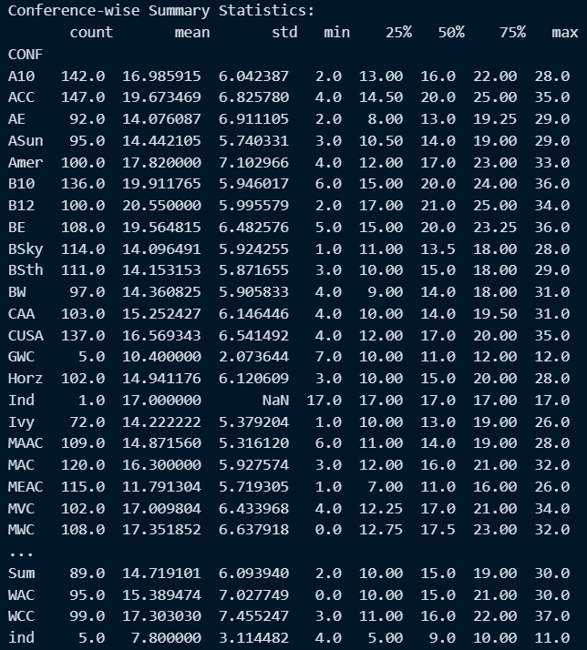
Conference Pairplot

Slide 42
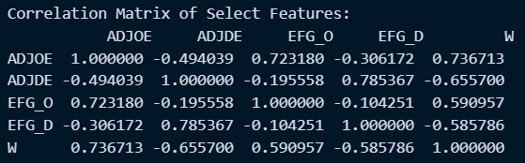
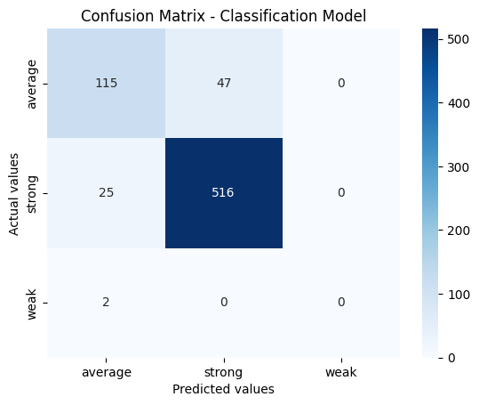
Correlation Matrix of Selected Features
Classification Model Accuracy: 0.90
Rating System Model Mean Squared Error: 0.0020537310204636386
Rating System Decision Tree Model Mean Squared Error: 0.0008799337730496454

Slide 43
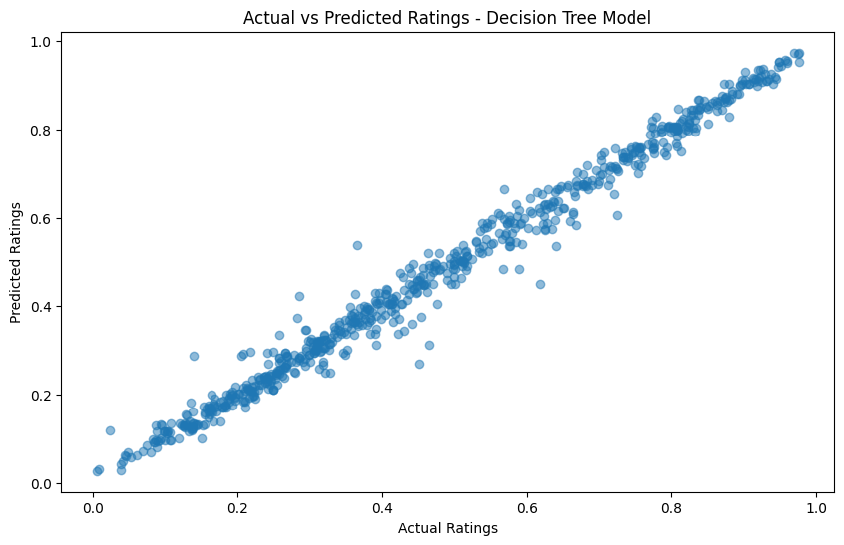

Slide 44
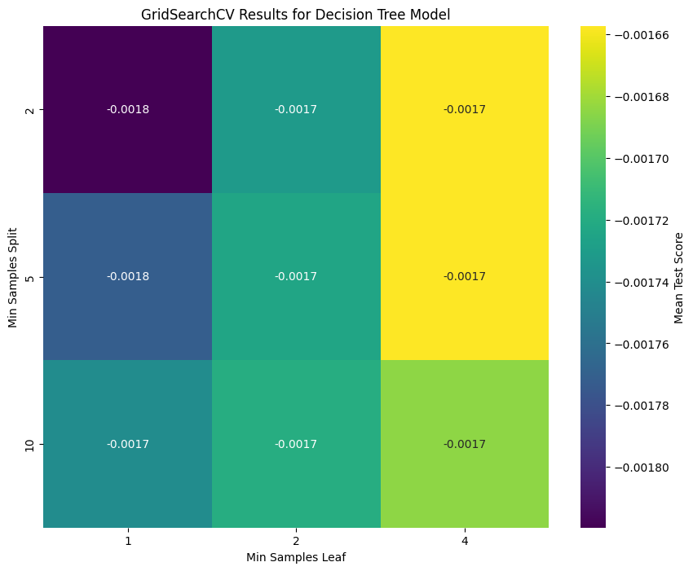
Using GridSearchCV
Rating System Decision Tree Model Mean Squared Error: 0.0007928285221738151
Best Parameters: {
'max_depth': None, 'min_samples_leaf': 4, 'min_samples_split’: 2
}

